Slide 1
Revisiting Nystrom
王思为

Slide 2
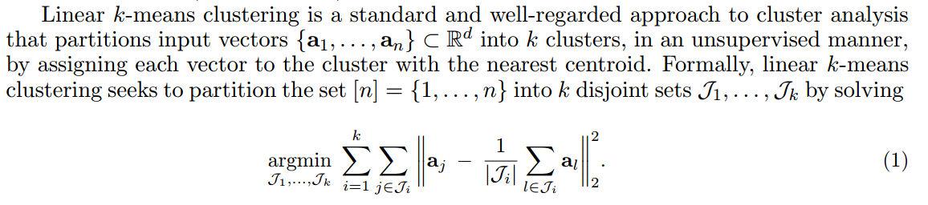

Slide 3
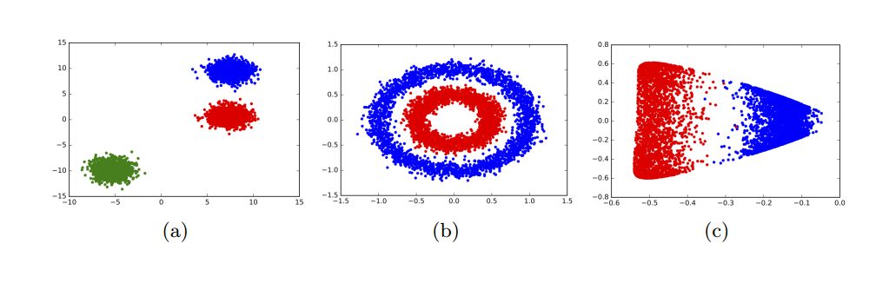
Applied to the data in Figure 1(a), Lloyd’s algorithm is perfectly capable of partitioning the data into three clusters which fit these assumptions. However, the data in Figure 1(b) do not fit these assumptions: the clusters are ring-shaped and have coincident centers, so minimizing the linear k-means objective does not recover these clusters.

Slide 4
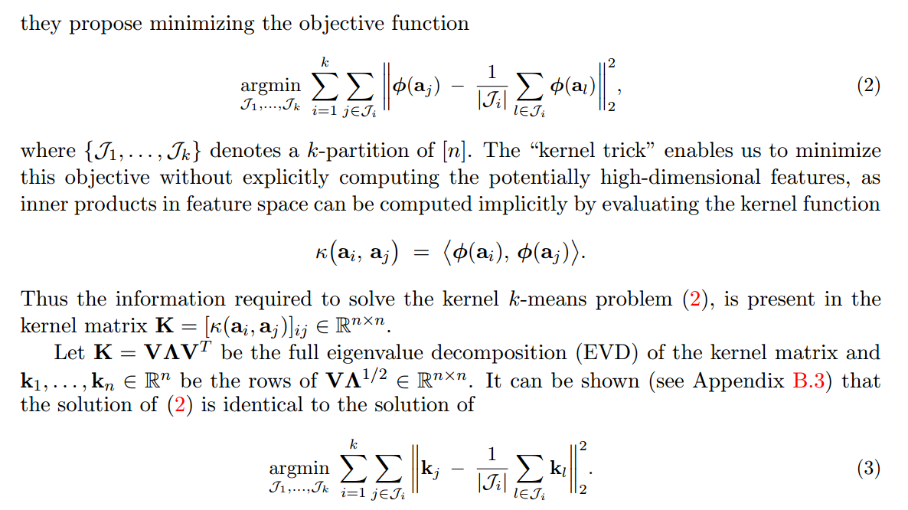

Slide 5
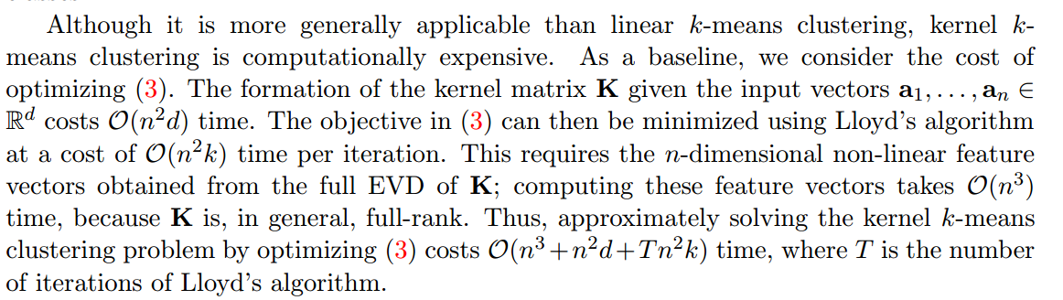

Slide 6
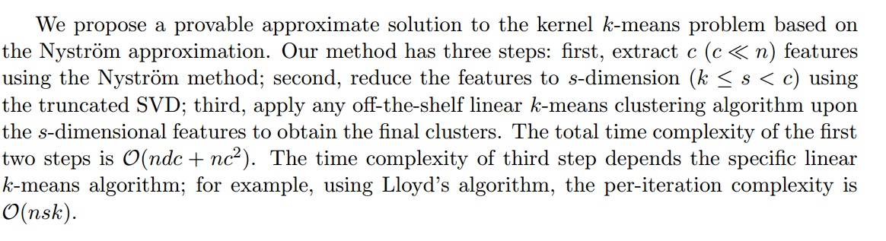

Slide 7
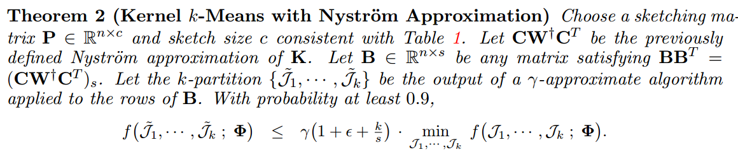
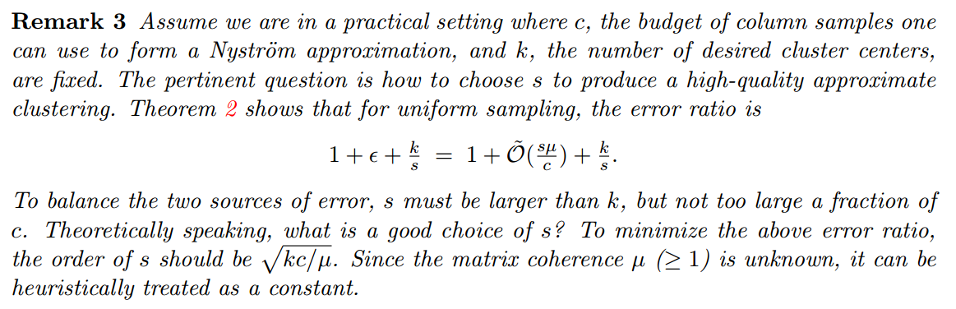

Slide 8
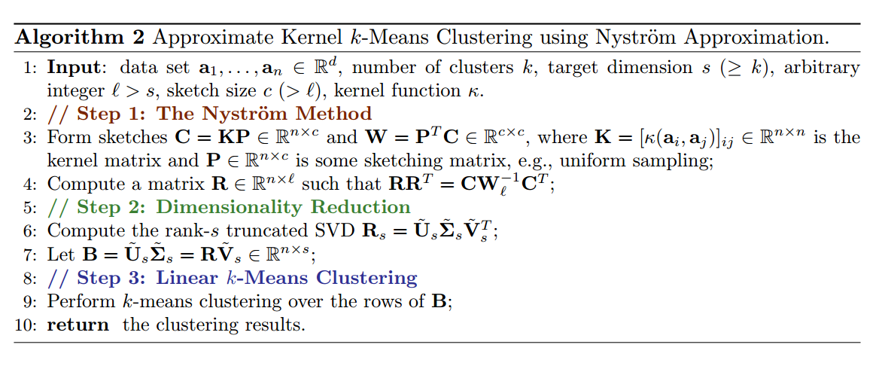

Slide 9
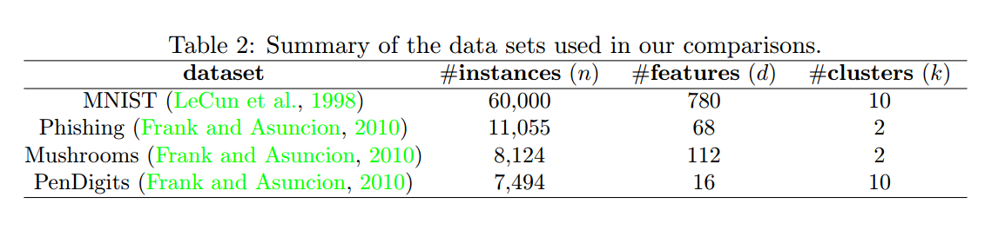

Slide 10
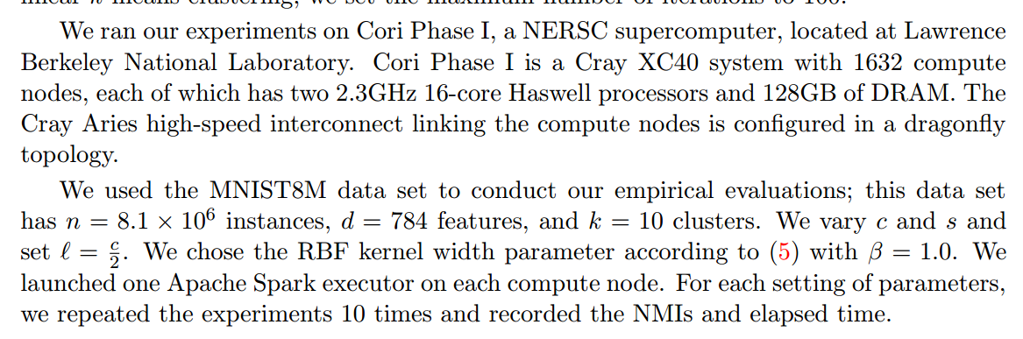

Slide 11
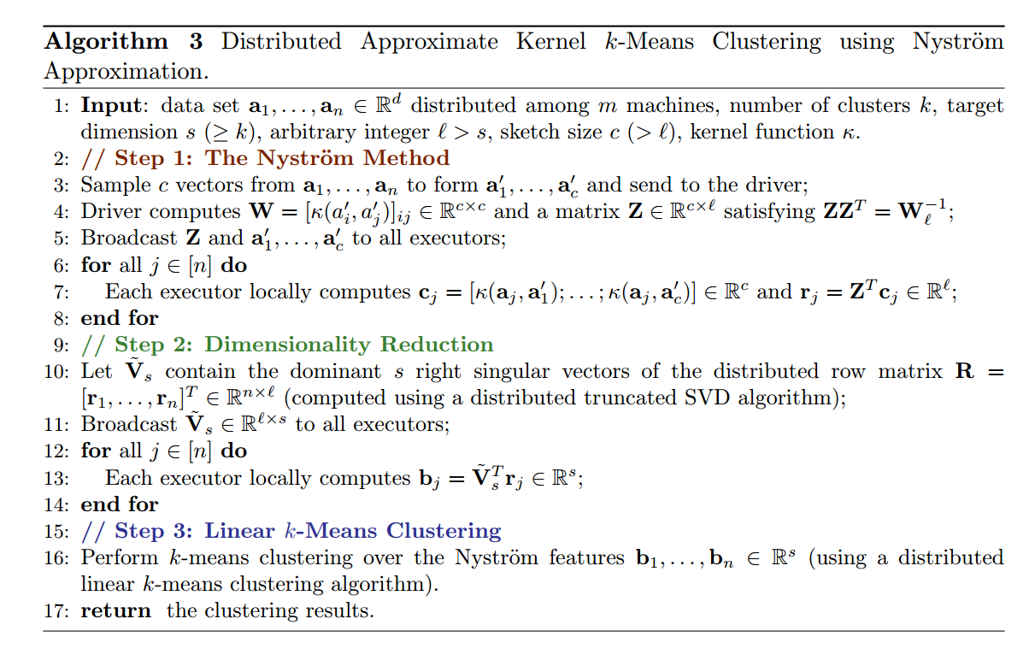

Slide 12
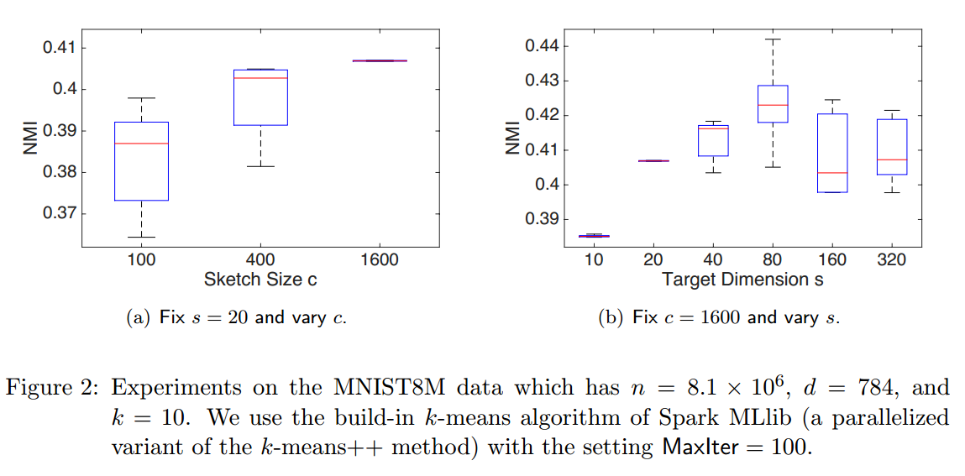

Slide 13
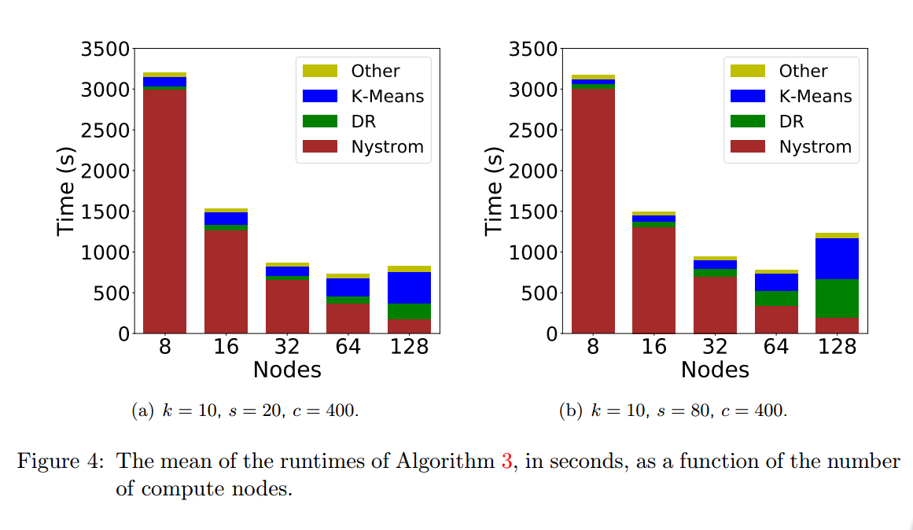

Slide 14
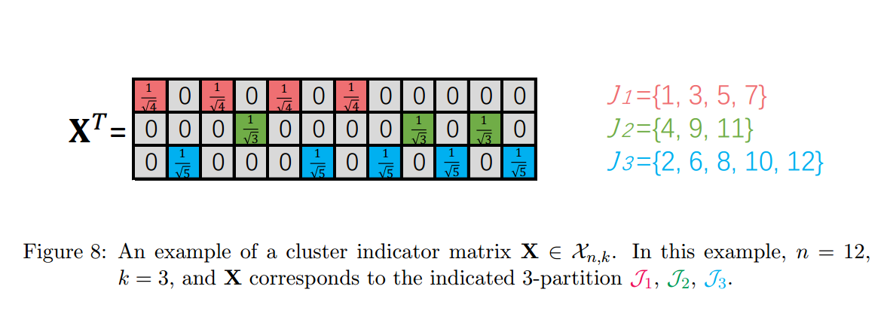

Slide 15
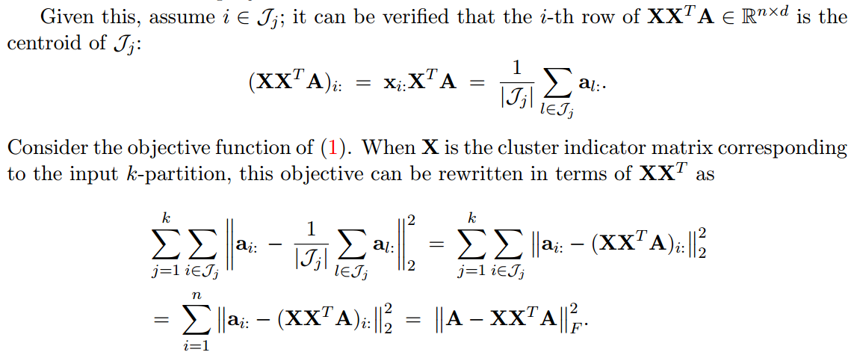

Slide 16
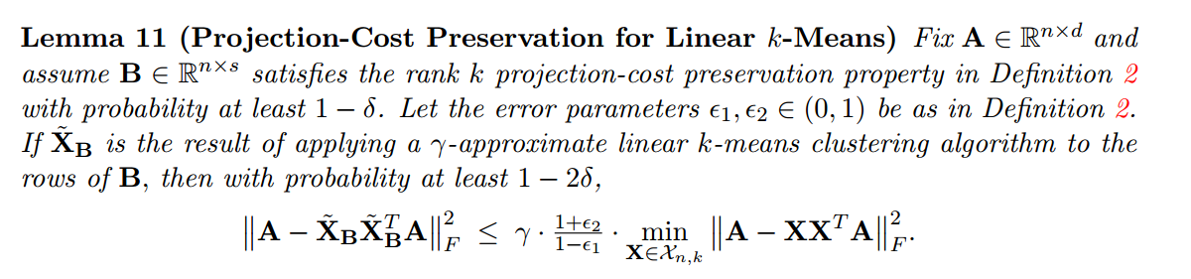

Slide 17
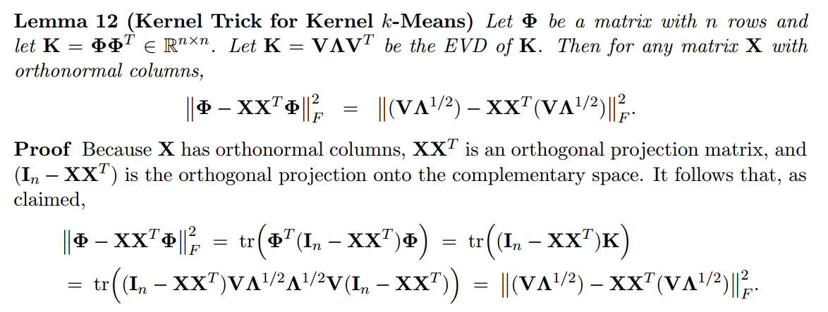

Slide 18
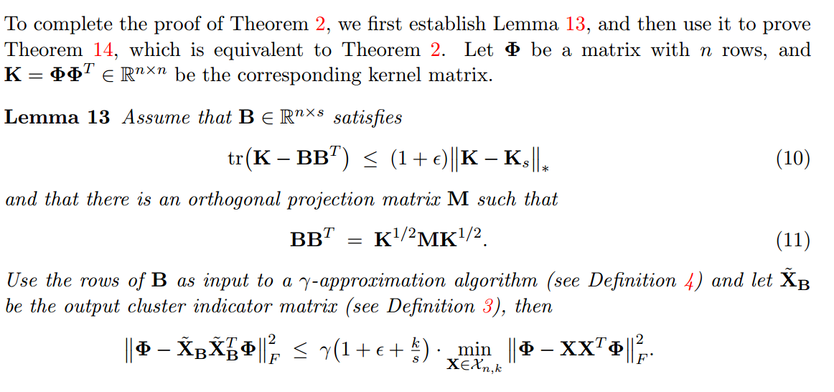

Slide 19
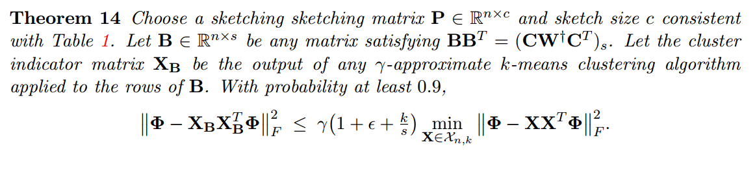

Slide 20
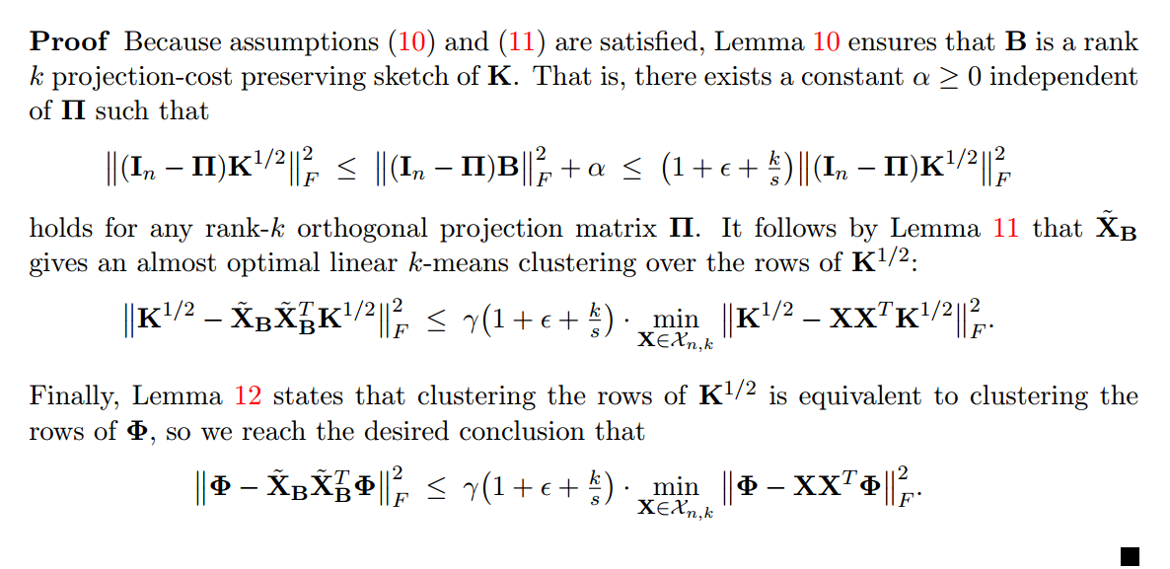

Slide 21
想法：
1.当前这个算法采用的是最简单的uniform sampling，能不能把之前的一系列的采样方法与之结合，改进下界？
2.分布式的实验我们也有环境，可以作为baseline

